Slide 1
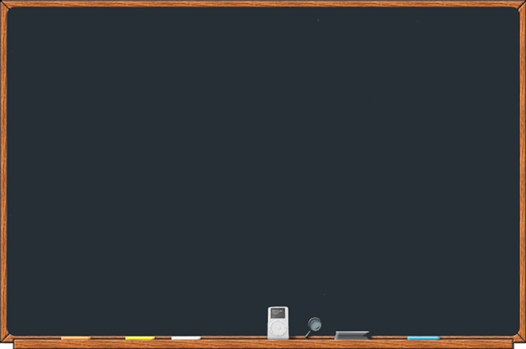
Welcome to Class 1
Miss Keeley, Mrs Wykes,
Miss Looms, Miss Lowry, Miss Read and Miss Jelley
will be working in Class 1
(Mrs Norton will lead PE)

Slide 2
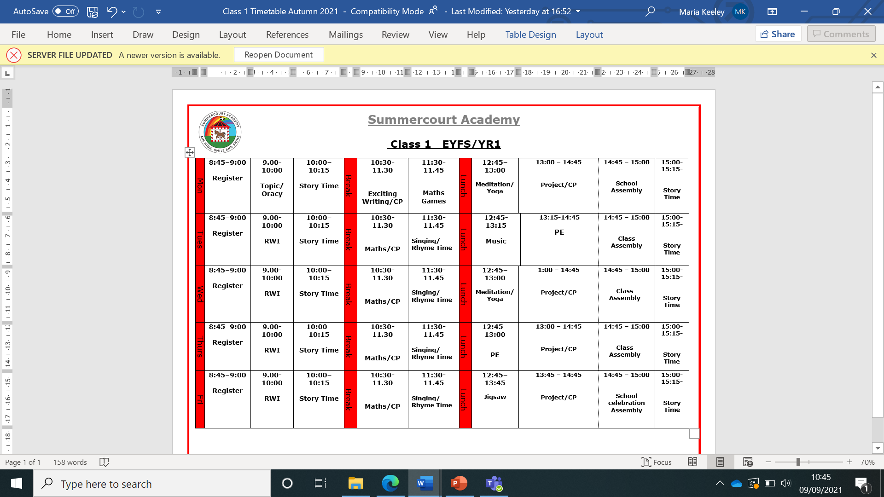

This is a working document and it is subject to change.

Slide 3
Lunches, Snacks and Water
Children need to bring a named water bottle everyday with clean fresh water in.
Free fruit is provided for children in Class 1 and 2.
Children need to bring one small healthy snack each day such as crackers, cereal bars or cheese.
Children can choose from the School Lunch Menu or bring a healthy well balanced lunchbox from home. Choices must be made on parent pay prior to the start of the school day. It is a good idea to book your child’s meals for the whole week or even the full half term at a time.
Class 1 will eat their lunch in the hall and then go outside to play with their friends.

Slide 4
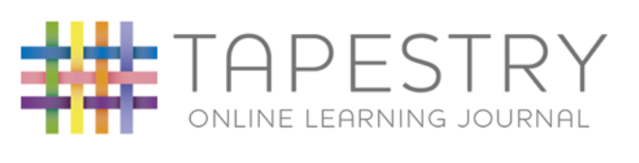
Tapestry - Log In (tapestryjournal.com)
At Summercourt Academy we use on online learning journal tool called Tapestry to record how your child is doing at school through observations and photographs.
Your child will have a Tapestry Account which will be available for you to access online and we encourage you to contribute to these by commenting on things your child does at home. This gives us a complete picture of what your child can do.

Slide 5
Reading
Reading Books - Initially your child will bring home a picture story book for you to share together, please talk about the characters, settings and events and how the story develops and concludes. When your child is ready they will then bring home a phonetically decodable reading book.
Reading Record – After reading please make a small comment in the yellow reading record about how your child has got in with the book. Please sign everyday. We will acknowledge your comments with a pink tick.
Please ensure their reading record and book are in school everyday.
Changing of books: children can change their books on Monday, Wednesday and Fridays.

Slide 6
Homework
In Class 1 we set short achievable homework tasks:
Homework | What is expected | When will it be given?
Reading Book | Please read daily and record in reading record. Children will have words to practice once set 1 sounds have been learnt. | Books changed on Mondays, Wednesdays and Fridays.
Writing | Please practice letter formation sheets | Every Monday in a green homework folder.
Maths | Please practice simple counting, matching and sorting activities. | Complete maths learning booklet given at the beginning of each half term.

Slide 7
Rewards and Expectations
Summercourt expectations are:
Be safe, be respectful and be ready!
We believe in praising positive behaviour and hard work!
  Summercourt tokens
  Stickers
  Certificates
  Inform parents

Slide 8
General Reminders
Ensure your child has the correct Uniform and PE kit.
Book bags must come to school everyday.
PE is usually on a Tuesday and Thursday (kits stay at school)
(Uniform guidance is on the school website and in your Starting School Booklet)
Please label all clothes and belongings
No personal pencil cases and toys in school
Please update us with any new medical needs – please ask the office for a medical form to fill in.

Slide 9
Any questions?
Please email them to the school.
Thank you all for your support!

