Slide 1
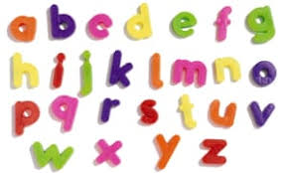

Phonics at Summercourt Academy

Slide 2
By sharing this with you, we aim to...
develop your confidence in supporting your child to read and write.
teach the basics of phonics with some useful phonological terms.
outline the different stages in phonological development.
show some examples of activities and resources we use to teach phonics.
explain the Phonics screening test for Year 1 children.

Slide 3
Phonics is all about……..
Segmenting and blending sounds to read and write.
Knowing what sounds the
letters make
+
Every child in Reception and Year 1 has a daily phonics lesson taught at their level. Once children are ready, usually at the beginning of Year 2 they move from phonics lessons to daily literacy lessons. ​Some children may need to continue to learn phonics until they are secure as phonics gradually progresses to learning spelling patterns and more complex words.

Slide 4
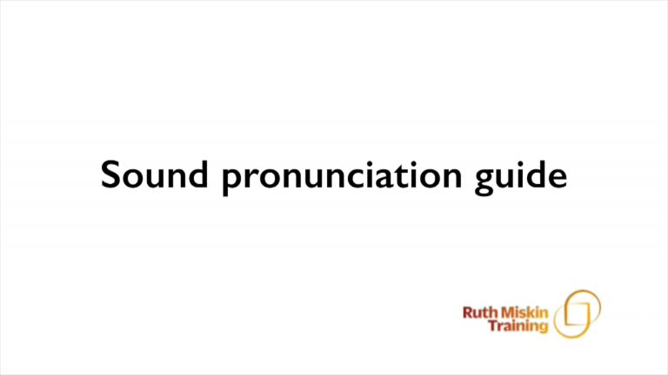
Phonemes – Sounds
Phonics: How to pronounce pure sounds | Oxford Owl - YouTube

Slide 5
Phonological terms
Phonemes: The smallest units of sound that are found within a word.
Grapheme: The sound represented in writing
Diagraph: Two letters that make one sound when read
Trigraphs: Three letters that make one sound
CVC: Stands for consonant, vowel, consonant.
Segmenting: Breaking up a word into its sounds.
Blending : Putting the sounds together to read a word
Tricky words: Words that are not decodable, we must learn these by sight.

Slide 6
English alphabetic code
44 phonemes (sounds)
Over 150+ graphemes
Only 26 letters
One of the most complex alphabetic codes in the world.
Notes:
In English we have more than 150 ways to represent 44 sounds, using the 26 letters in the alphabet.
This means we have to group letters together to write some sounds. Show with a grapheme such as ‘igh’.
This makes our language one of the most complex in the world!

Slide 7
Blending
/b/ /e/ /d/ = bed
/t/ /i/ /n/ = tin
/sh/ /o/ /p/ =shop

Slide 8
Segmenting
bed = /b/ /e/ /d/
tin= /t/ /i/ /n/
shop= /sh/ /o/ /p/

Slide 9
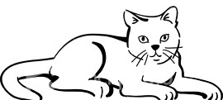

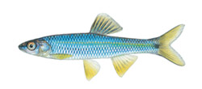
We use sound buttons or phoneme frames to split up the sounds. We use Fred Fingers to spell out the sounds.
c | a | t
f i sh
. . _

Slide 10
How many sounds are in these words?
it log duck fill
shop light frog
brick green stamp

Slide 11
Common exception words (Tricky words/high frequency words)
There are many words that cannot be blended or segmented by sound because they are irregular but very common in text, e.g.
the was said you some he she we no go to I a

Slide 12
Daily Phonics
Every day the children have a 30-60minute session of phonics, this includes reading and writing practice. Reception children will initially have a carousel of short activities for learning sounds, reading words and letter formation.
When ready they move onto coloured banded books where they practice reading for fluency and comprehension. Also holding a short sentence and spelling out words for writing. From YR-Y1 the children progress through the coloured books.
We use a programme called Read, Write Inc which has been specifically developed for children in the Early Years and Key Stage 1.
Notes:
Phoneme frames, sound buttons, full circle, countdown, flashcards, buried treasure

Slide 13
Let’s have a look at some of the resources we use in our RWI programme

Slide 14
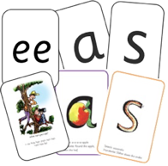
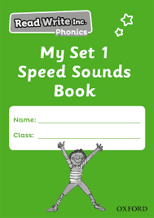



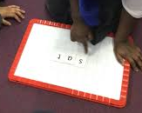
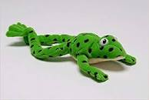
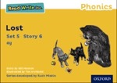
Sound cards and mini books
Green and red word cards
Magnetic tiles
Coloured banded reading books
Fred
Notes:
Read Write Inc. Phonics is a programme that uses systematic phonics to teach all children to read.
It lasts two years for most children - if they start to learn to read in the Reception class.
(There are some children with learning difficulties who spend longer on the programme.)
Click – We teach the sounds first – in a specific order.
Click – We then teach your children to blend those sounds together in order to read words
Click – The children read words in the matched Storybooks. Each Storybook is carefully matched to the sounds they can already read - setting them up for success.
Click – We read to children ‘real’ books’. Once they have learnt to read, they will be able to independently read these books for themselves.

Slide 15
At home
Class 1 will bring home a library book to share at home. Once they have learnt all of the Set 1 sounds, the library book will be swapped for their first decodable reading book. We will change books twice a week. Children will also have some key word lists in their reading records to practice at home. Children will have a handwriting/letter formation sheet each week. Once ready this will change to high frequency word spelling sheets.
Class 2 will bring home a reading book from our Accelerated Reader programme. They will do an online quiz answering questions about their book in the class using an ipad. Books changed once read and weekly spelling patterns.

Slide 16
Online resources and games
Ruth Miskin Parents’ Page:
http://www.ruthmiskin.com/en/find-out-more/parents/
Ruth Miskin Facebook:
https://www.facebook.com/miskin.education
Free e-books for home reading:
http://www.oxfordowl.co.uk/Reading/
Free or subscription games:
https://www.phonicsplay.co.uk/
https://www.phonicsbloom.com/uk/game/list/phonics-games
https://learn.readwithphonics.com/school/phonics-games/make-a-word
https://www.ictgames.com/mobilePage/literacy.html

Slide 17
Year 1 Phonics Screening Check
Every Year 1 child in the country will be takes a statutory phonic screening check.
The aim of the check is to ensure that all children are able to decode words for reading by the end of Year Two.
This ‘midpoint check’ will ensure that we have a clear understanding of what the children need to practice in Year Two.
The check is very similar to tasks the children already take part in during phonics lessons. The resources will already be familiar.
Children will be asked to ‘sound out’ a word and blend the sounds together.eg d-o-g – dog
The children will be asked to read pseudo/‘nonsense’ words and real words.

Slide 18
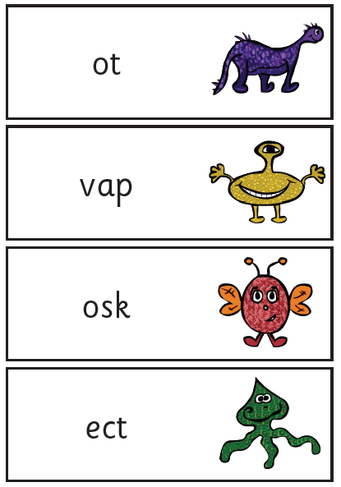
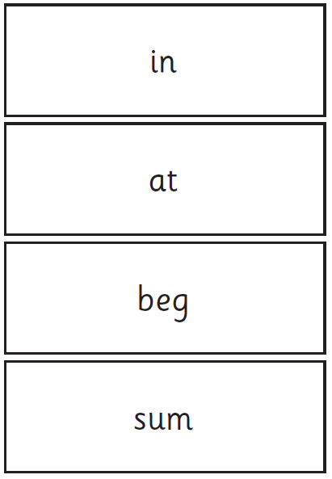
These are the resources

Slide 19
How will the test be done?
The children will complete the check one at a time in a quiet area of the school. The class teacher will conduct all of the screening checks with the children.
The children are not given a set time and may have a break between each section of the booklet.
Consideration is given for regional accents. If children mispronounce sounds due to their speech development this is taken into consideration too.
Last years pass mark was 32/40.
Children who do not meet the required standard will be retested in the Summer of Year Two.

