Slide 1
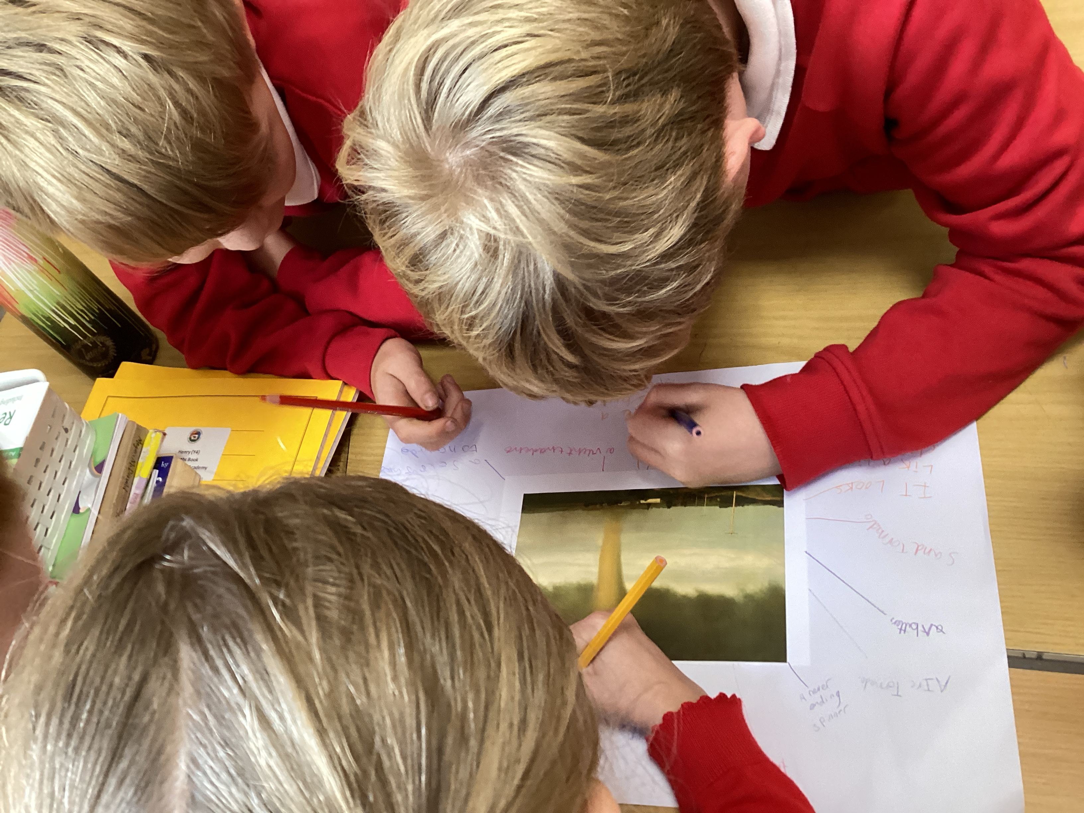
Class 3 2022-23 Summercourt Academy Mrs Blamires, Mrs Waters, Miss Potthurst and Mrs Canning

Slide 2
About the Class teacher – Mrs Blamires

Slide 3
Curriculum Map
Every term the children will bring home a copy of our class curriculum map outlining the direction of the learning.
Our weekly newsletters also highlight some of the key foci for the next week’s learning.

Slide 4
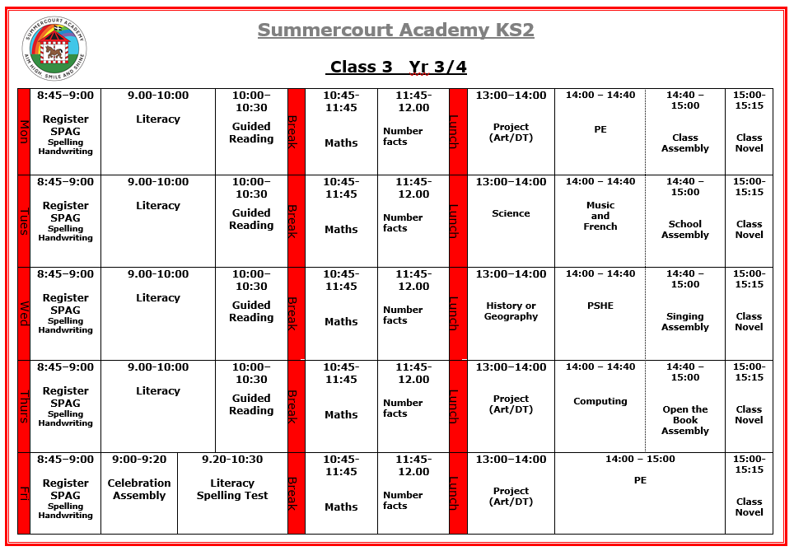
Timetable

Slide 5
Class procedures
Hand washing – children are encouraged to wash their hands before break, lunch and every time they use the bathroom.
Seating plan – the seating plan is fairly flexible (we can and do change it as necessary). Where children sit can really impact their learning, both positively and negatively, so it’s important they - or you - express concerns.
Lunch – (12:00 – 13:00) The children have outdoor play both before and after eating their lunch. If the children don’t bring a packed lunch and there is no hot dinner booked, they will be given the pasta option.
Break times – (10:30 – 10:45) Healthy snack encouraged.
Toilets – children are encouraged to go in their break times but we are quite flexible.

Slide 6
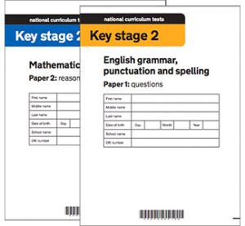
Assessment
In order to see the children’s progress and to quickly identify any gaps they may have in their learning, they will complete a number of assessments (tests) in a range of subject areas.
Termly maths assessments
Termly writing moderation
Termly reading assessments
End of year assessments

Slide 7
Homework
Maths worksheet to be posted on the Google Classroom weekly (the same way that it was accessed during lockdown).
Spelling lists following the spelling patterns for Years 3 and 4. Spelling tests will be on Fridays.
Reading and reading expectations: We are encouraging children to read every day. Reading books can be changed whenever the child has quizzed. Children will be expected to have a signed reading record in school daily.

Slide 8
Rewards
School and class reward scheme – children can earn tokens for their class ‘jar’ from any adult in school for demonstrating top behaviour, being kind, doing their best in learning (and other things).
Children can also earn stickers and mini certificates within learning time for all kinds of reasons.
We follow the school’s behaviour and positive relationships policy across all the classes.

Slide 9
Calculation Policy
Each year group will be taught to calculate in a specific way to enable them to progress and understand the methods being used. Please encourage your child/children to demonstrate these methods and practice using them at home. The policy can be found on the school website.

Slide 10
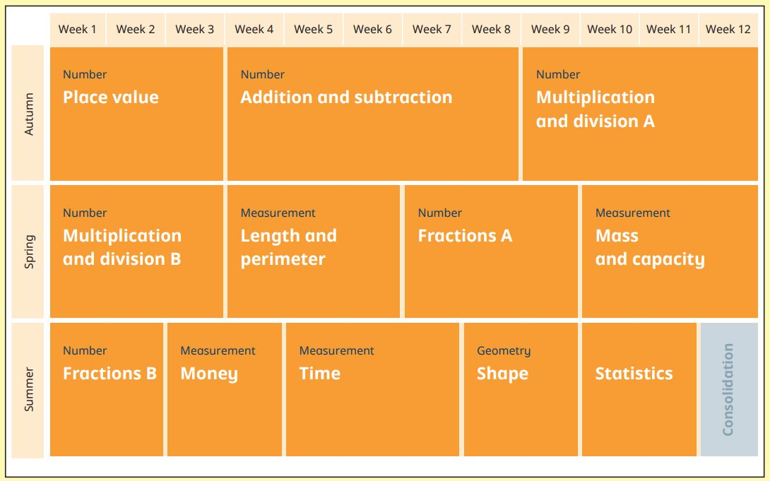
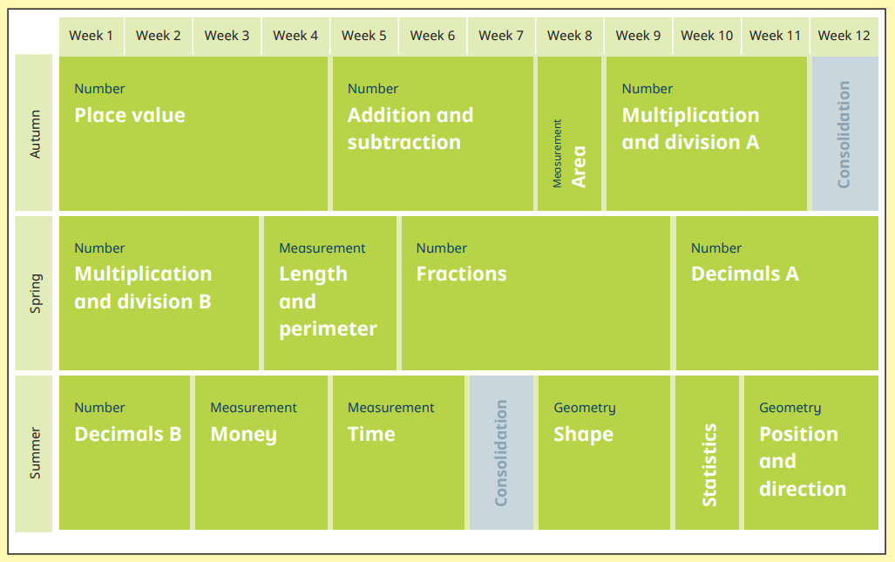
Maths
In Maths, we follow the White Rose Maths scheme. We use the resources and plan according to their timelines. Here is an example of what your children will be learning:

Slide 11
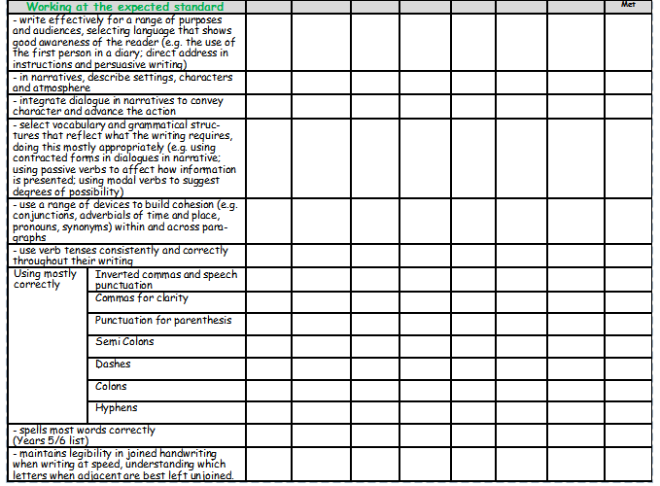
Writing
This is a copy of the writing criteria we use to assess children’s writing.
There are three different levels within each year group:
WTS – working towards the standard
EXS – expected standard
GDS – greater depth

Slide 12
Management Structure
Teaching Assistants/Class Teacher
Head of School
Senior Leadership

Slide 13
Extras
Children need PE kits in school for Monday and Friday.
Coats – can children have a raincoat in school every day please?
Uniform, PE kit, coats -everything labelled with their name please ☺
Trips and Residential - information about the residential will hopefully be confirmed by January. The class do at least one trip a term also – please be aware that transport costs have increased and this may have a knock-on effect on the price of trips.
Boosters & Incremental teaching – your child may be invited to attend afterschool boosters and incremental teaching (small step teaching by another teacher in school which addresses one particular skill). You will find out via email or letter if this is the case
Children cannot bring in pencil cases; any toys or fidget devices must be pre-arranged with teacher and are according to the need of the child.

Slide 14
Questions
Feel free to make contact with me or any other adults via Mrs Rusted in the office or catch one of us in the playground. Any concern you have is worth mentioning.

