Slide 1
Welcome to Class 2 !
Mrs Staff
Mrs Lowry, Miss Wastie
and Mrs Canning
will be working in Class 2
(Mrs Norton will continue to lead PE, usually on Monday and Thursday afternoons)

Slide 2
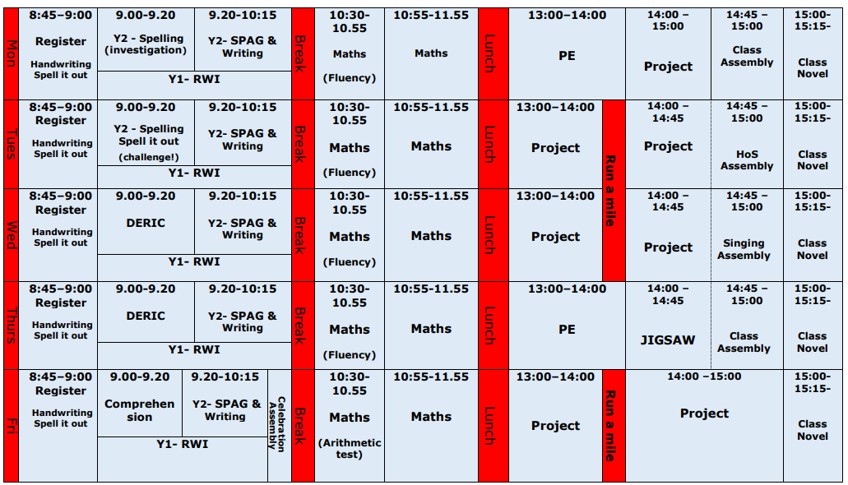
This is a working document and it is subject to change.
Our cleaning routine is not included in this timetable.

Slide 3
Lunches, Snacks and Water
Children can choose from the School Lunch Menu or
bring a Homemade Healthy Packed Lunch.
Lunch time arrangement: Eat lunch first (about 30 minutes), play when they have finished.
Free fruit is provided for KS1. Cool milk can be ordered in advance with the office.
Healthy tuck can be brought in, from home, as a snack for break times. (NO NUTS)
Children need to bring in their water bottle everyday.

Slide 4
Homework
Reading (daily) – practice both fluency and comprehension
Maths (weekly) on a Friday and due in the following Friday. Work either set on Google classroom or given directly to your child. Your child’s login ‘magic square’ is on the back of their reading record.
Spelling homework: More on this in a bit.
Additional homework may occasionally be set
if children need further practice with a particular
skills or work in class.

Slide 5
Reading at school
Phonics: R.W.I programme
High quality texts used in English lessons and across the curriculum
Accelerated Reader (after graduated from RWI)
ERIC X 2 weekly
1:1 reading with an adult when possible
Phonics interventions
Class novel

Slide 6
Homework - Reading
Children have been given a Home reading folder each, which may include their RWI books or an AR book, and a Recommended book – please ensure this folder are in school everyday. (Appropriate bag)
Your child will learn HOW to read during Phonics and Guided reading sessions in class.
These skills will then be practiced at home - little and often, (10 mins daily is a good aim). We want children to enjoy reading and sharing books with you!
Reading Record – Please sign your child’s record daily to celebrate the reading that it taking place at home. Please indicate which page is next or if the book is finished so we can remind them to change their book; You may want to note any success and/or difficulties.

Slide 7
Homework - Reading
We check the children’s reading records daily. If you have any questions or comments regarding homework please do record them here and we will get back to you as quickly as possible.
We will tick/answer your comment in pink pen to show that we have seen it.
When they have finished an AR book, children will take a quiz to check their understanding.
Changing of books: children can change their books any day, once they have finished reading their book.

Slide 8
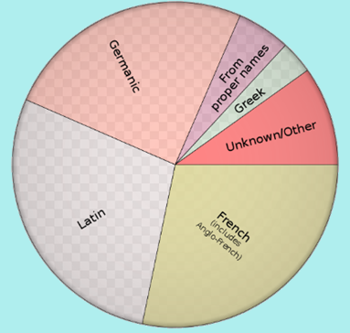
Spelling
Lots of children (and adults!) find spelling tricky because English is a real melting pot of languages.
Modern English is based on a least forty sounds but the alphabet has only twenty-six letters.
A lot of the English language is no longer phonetic in spelling. This means that in many cases that which is written is not what is said. Pronunciations have significantly changed over the centuries, while spellings have not kept up or have not changed at all.
The spelling of knight, for example, reflects the way that it was spoken centuries ago when there were almost no "silent letters."

Slide 9
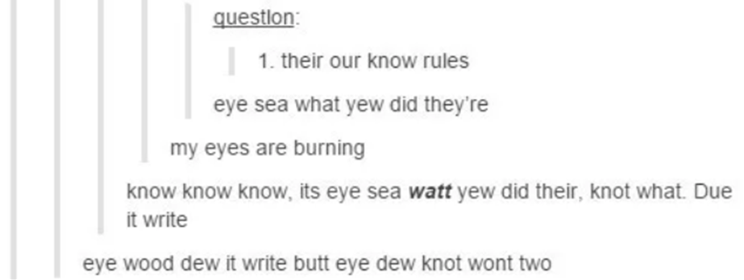
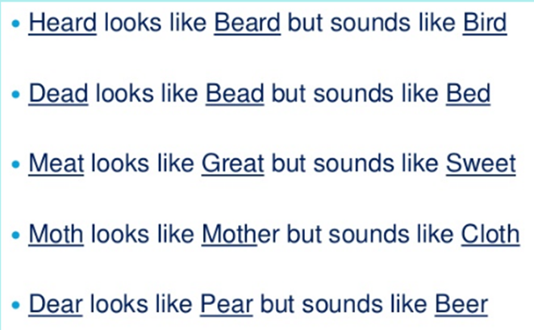
Spelling

Slide 10
Spelling – How do we teach it?

Slide 11
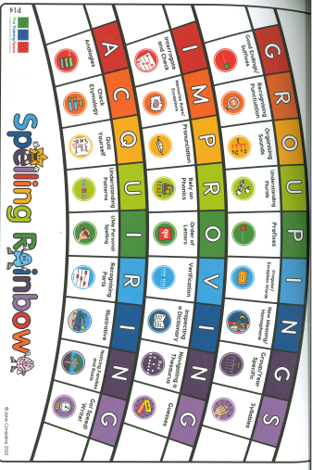
Spelling – How do we teach it?

Slide 12
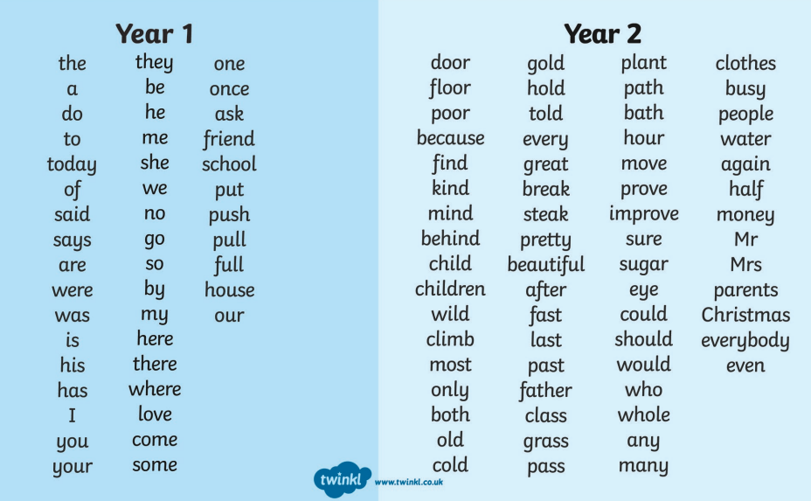
Spelling
Children are expected to be able to confidently spell all of these words by the end of year 2!
This list is included inside your child’s reading record.

Slide 13
Homework – Spelling
Excitingly, this year we are changing the way in which we teach spelling.
We will be following the award winning spelling scheme “The Spelling Book” by Jane Considine.
The scheme involves a shift away from the testing of spelling and dedicates more time to teaching and learning.
This involves a focus on etymology, prefixes and suffixes, patterns, phonics, homophones and more!

Slide 14
Homework – Spelling
These changes mean that we will no longer be providing weekly list of spellings.
Instead, fortnightly, we will share a list of 15 words which we will be exploring in class.

Slide 15
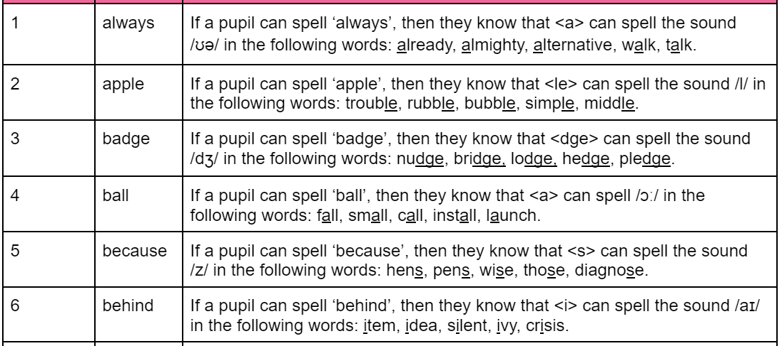
Homework – Spelling
.
Children will not be completing traditional spelling tests. More of a spelling check and discussion.
We will no longer be sending home a spelling score.

Slide 16
Homework - Maths
Apart from homework, activities to practice Maths at home:
For fluency: Practice regularly with your child:
counting (forwards and especially backwards) in 1s, 2s, 5s, 10s
number facts within 20 (see table on the next slide)
Play board games (any games with dice)
Counting money with different coins
Telling the time
o’clock, half past (Y1),
quarter past, quarter to and in 5-minute intervals (Y2)
Sharing food into equal parts (division and fraction: halves, quarters, thirds)
Cooking, measuring, reading measurements

Slide 17
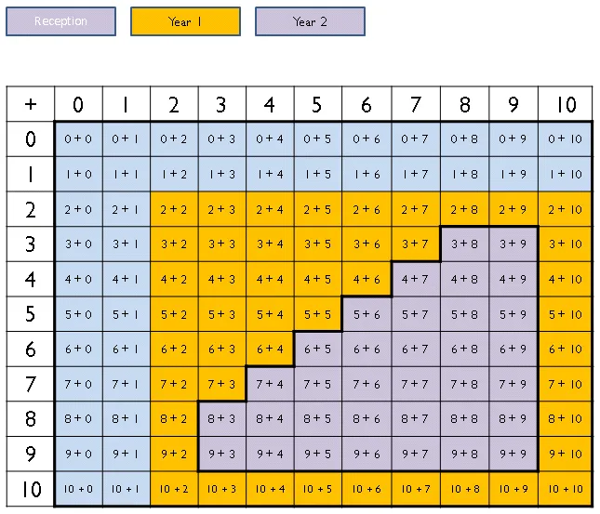
Learning number facts

Slide 18
Rewards and Sanctions
We believe in praising
positive behaviour and hard work!
Summercourt expectations (Be safe, be respectful and be ready)
Summercourt tokens
Stickers
Achievers’ assembly and certificates
Phone calls and chats with parents

Slide 19
Curriculum

Slide 20
General Reminders

Slide 21
General Reminders
Ensure your child has correct Uniform and PE kit
(PE is on a Monday and Friday afternoon)
(Uniform guidance are on school website)
Names in all clothes and belongings
No personal pencil cases and toys
Medical needs up to date – please ask me for a form if you need one.

Slide 22
Thank you for your support!
Any questions?

