Slide 1

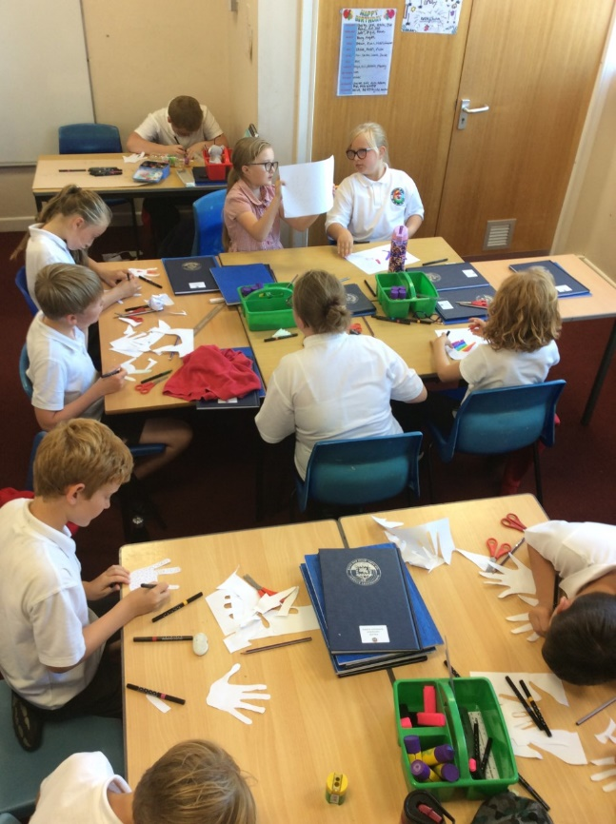
Class 4
Summercourt Academy
Mr Kelly, Miss Simmonds, Miss Wastie and Mrs Norton

Slide 2
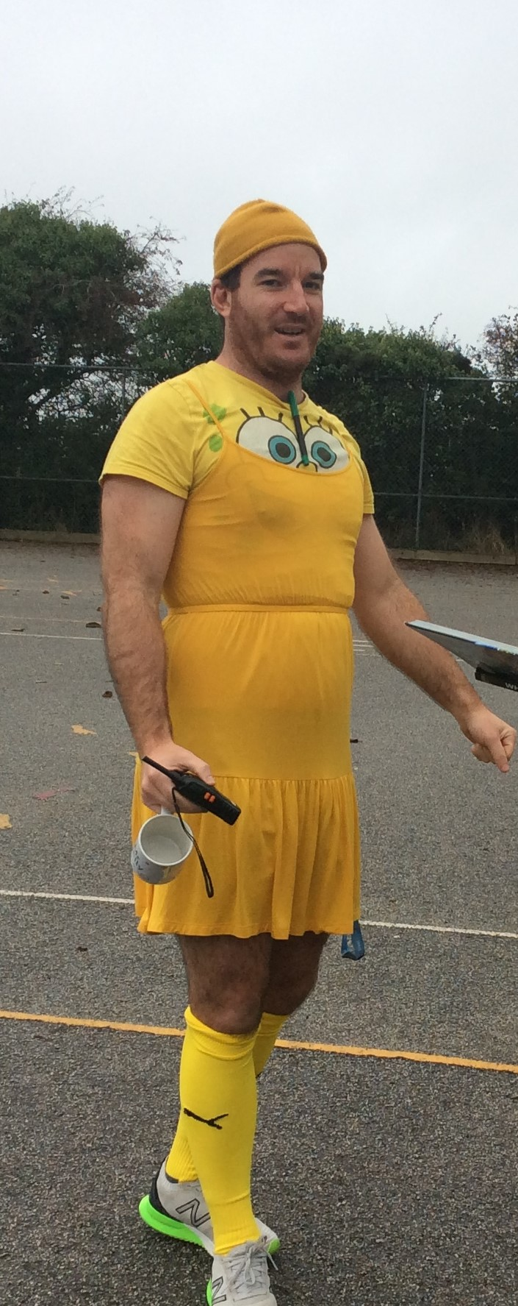
About the Class teacher – Mr Kelly
Hello, am the Class 4 teacher and steer the children in Y5 and Y6 through their learning and in the case of Y6, through their SATs also. As you might be able to notice, I quite enjoy the days where we don’t have to wear uniform and we can dress up. The children around school know me for playing lots of different sports (rugby outside of school) and they know they I always need my coffees in the morning. I really enjoy interesting conversations with children and like to hear their curious and quirky stories.

Slide 3

Curriculum Map
Every term the children will bring home a copy of our class curriculum map outlining the direction of the learning.
Our weekly newsletters also highlight some of the key focusses for the next weeks learning.

Slide 4


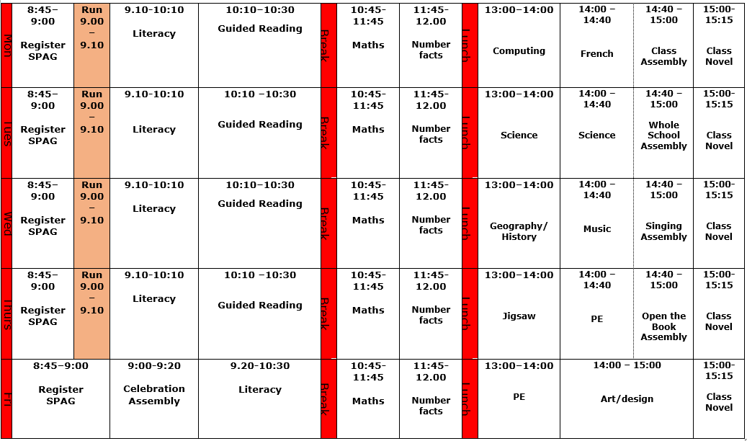



Timetable

Slide 5
Class procedures
Hand washing – children are encouraged to wash their hands before break, lunch and every time they use the bathroom.
Seating plan – the seating plan is fairly flexible (we can and do change it as necessary). It is also one of the most impactful elements on learning for some children so it’s important they - or you - express concerns.
Lunches – (12:00 – 13:00)children have approximately 30 minutes of break time before being called into the dining hall where they can continue their leisure time once finished of there is time.
Break times – (10:30 – 10:45) healthy snack encouraged.
Toilets – children encouraged to go in their break times but I am largely quite flexible.

Slide 6


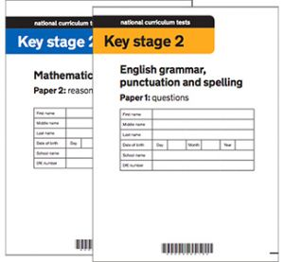
Curriculum and assessment
In order to see the children’s gaps and progress, they will complete a number of assessments (tests) in a range of subject areas.
Termly maths assessments
Termly writing moderation
Termly reading assessments
End of year assessments
Year 6 - SATs

Slide 7
Homework
Maths worksheet to be posted on the Google Classroom weekly (the same way that it was accessed during lockdown).
Y6 CGP workbooks…. post Christmas
Spelling lists and tests (there may be times when it doesn’t done but the children are still to practise their weekly lists).
Reading and reading expectations. We are encouraging children to read every day. Reading books can be changed whenever the child has quizzed. Children will be expected to have a signed reading record in school daily.

Slide 8
Rewards
School and class reward scheme – children can earn tokens for their class ‘jar’ from any adult in school for demonstrating top behaviour, being kind, doing their best in learning (and other things).
Children’s can also reach the stars (class 4 reward system) which earns them a treat from the box if they have an excellent day.
We follow the school’s behaviour and positive relationships policy across the classes.

Slide 9
Calculation Policy
Each year group will be taught to calculate in a specific way to enable them to progress and understand the methods being used. Please encourage your child/children to demonstrate these methods and practice using them at home. The policy can be found on the school website.

Slide 10
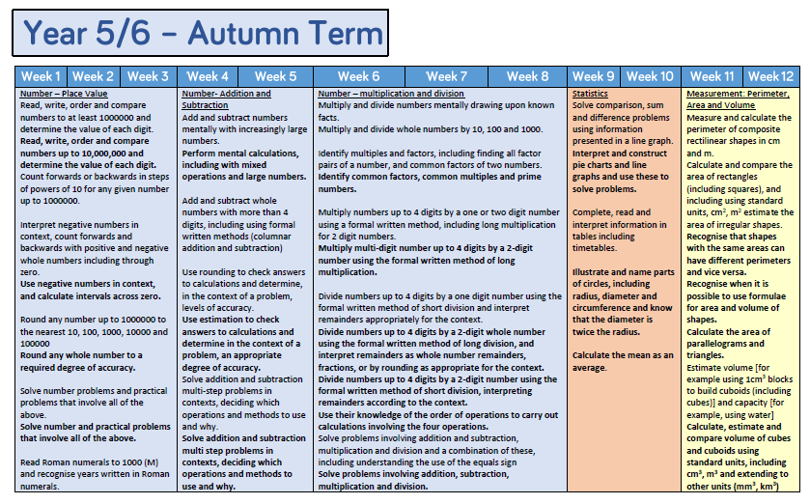
Maths
In maths, we largely follow a Whiterosemaths programme. We use the resources and plan according to their timelines. This is an example of the skills breakdown into weeks.

Slide 11

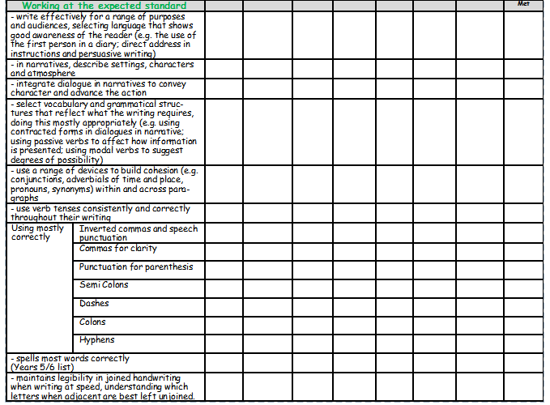
Writing
This is a copy of the writing criteria we use to assess children’s writing.
There are three different levels within each year group:
WTS – working towards the standard
EXS – expected standard
GDS – greater depth

Slide 12
Management Structure
Teaching Assistants/Class Teacher
Head of School
Senior Leadership

Slide 13
Extras
Children need PE kits in school for Thursday and Friday.
Coats – can children have a raincoat in school every day please.
Uniform, PE kit, coats -everything labelled with their name please ☺
Trips and Residential - information about the residential will hopefully be confirmed by January. The class do at least one trip a term also – please be aware that transport costs have increased and this may have a knock-on effect on the price of trips.
Boosters & Incremental teaching – your child may be invited to attend afterschool boosters and incremental teaching (small step teaching by another teacher in school which addresses one particular skill). You will find out via email or letter if this is the case
Children can bring in pencil cases *students cannot bring in toys or fidget devices unless pre-arranged with teacher.

Slide 14
Questions
Feel free to make contact with me or any other adults via Mrs Rusted in the office or catch one of us in the playground. We find that any concern is worth mentioning.

